Slide 1
5
INVERSE FUNCTIONS

Slide 2
5.7
Hyperbolic Functions

Slide 3
Hyperbolic Functions
Certain even and odd combinations of the exponential functions e^{x} and e^{–x} arise so frequently in mathematics and its applications that they deserve to be given special names. In many ways they are analogous to the trigonometric functions, and they have the same relationship to the hyperbola that the trigonometric functions have to the circle.
For this reason they are collectively called hyperbolic functions and individually called hyperbolic sine, hyperbolic cosine, and so on.

Slide 4
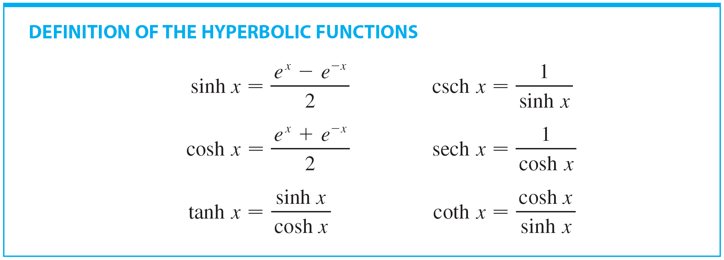
Hyperbolic Functions
Following is the definition of the hyperbolic functions.

Slide 5
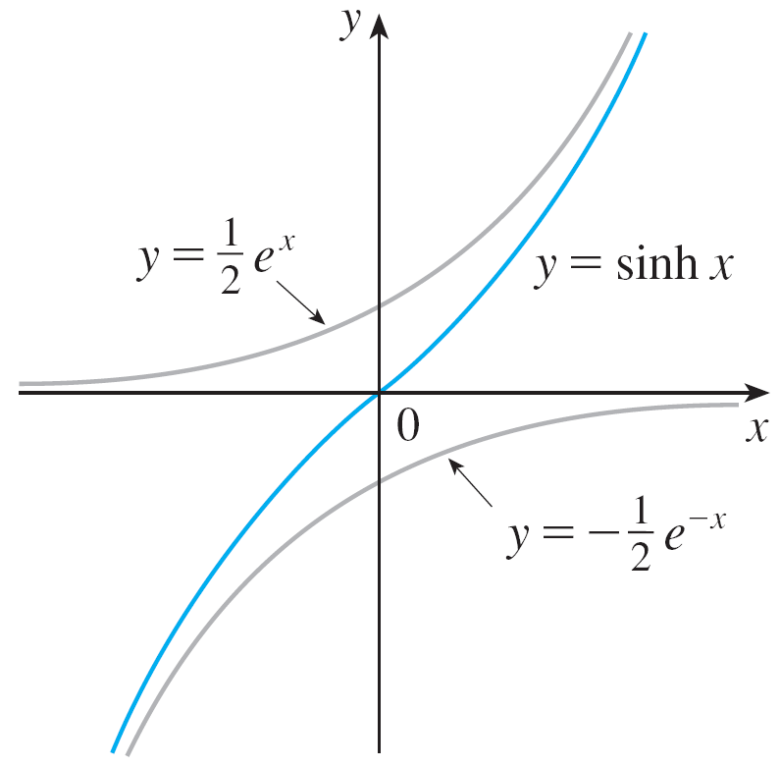
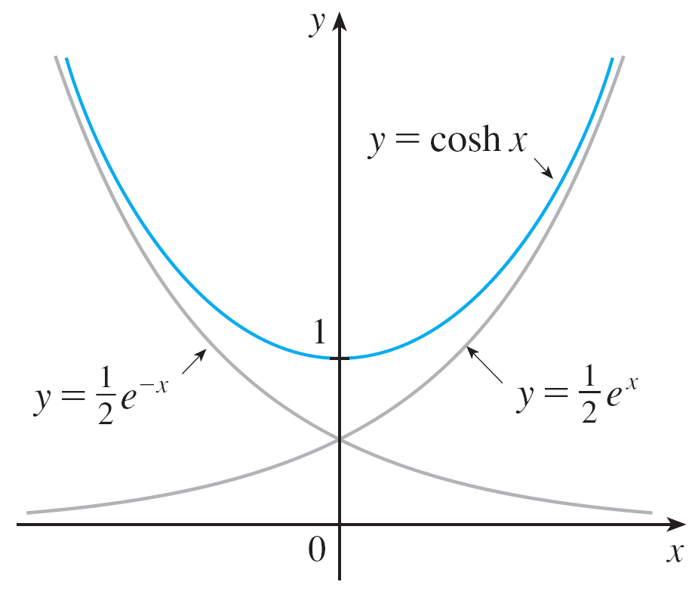


Hyperbolic Functions
The graphs of hyperbolic sine and cosine can be sketched using graphical addition as in Figures 1 and 2.
Figure 1
Figure 2

Slide 6

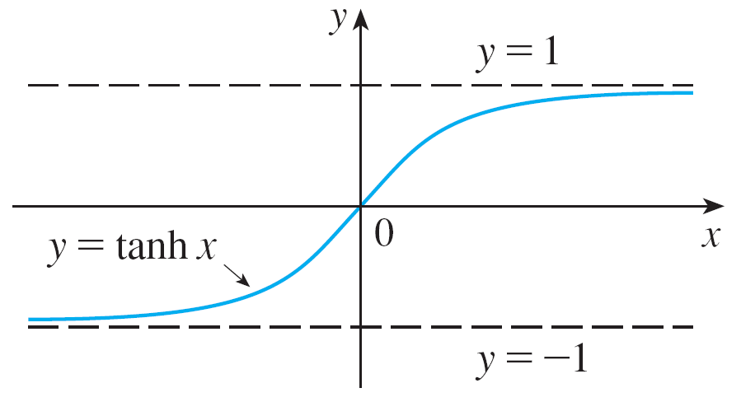
Hyperbolic Functions
Note that sinh has domain and range , while cosh has domain and range [1, ). The graph of tanh is shown in Figure 3.
It has the horizontal asymptotes y = ±1.
Figure 3

Slide 7
Hyperbolic Functions
Applications of hyperbolic functions to science and
engineering occur whenever an entity such as light,
velocity, electricity, or radioactivity is gradually absorbed or extinguished, for the decay can be represented by
hyperbolic functions.

Slide 8
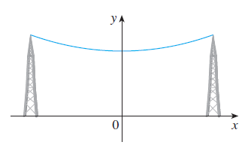
Hyperbolic Functions
The most famous application is the use of hyperbolic cosine to describe the shape of a hanging wire.
It can be proved that a heavy flexible cable (such as a telephone or power line) is suspended between two points at the same height, then it takes the shape of a curve with equation y = c + a cosh (x/a) called a catenary (see Figure 4).
Figure 4

Slide 9
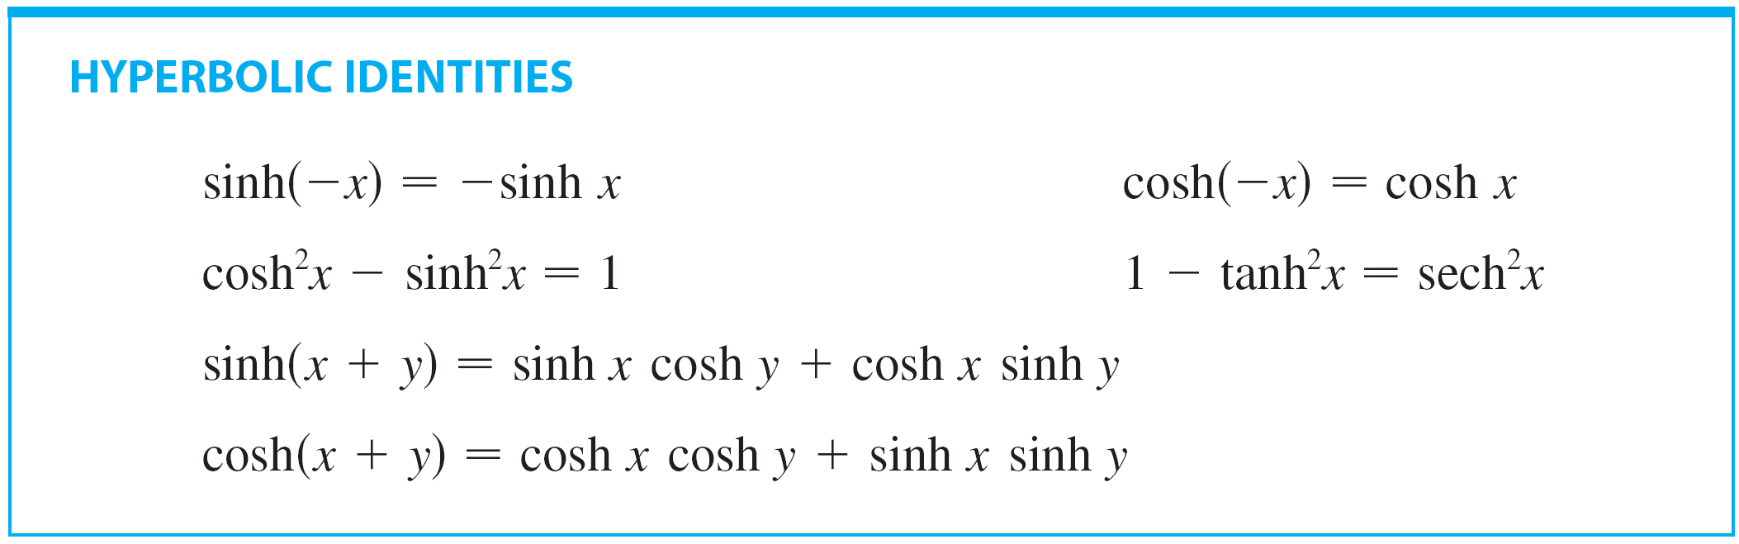
Hyperbolic Functions
The hyperbolic functions satisfy a number of identities that are similar to well-known trigonometric identities.

Slide 10


Example 1
Prove (a) and
(b)

Slide 11
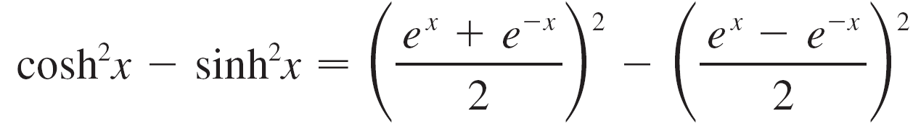
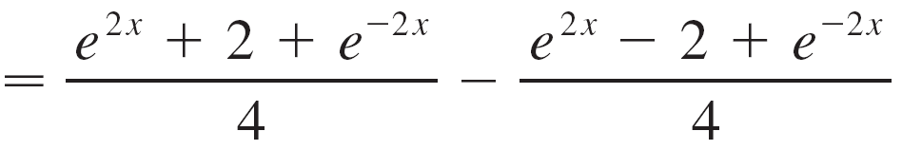

Example 1 – Solution
SOLUTION:
(a)

Slide 12

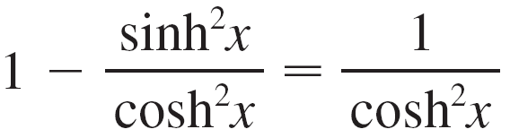

Example 1 – Solution
cont’d
(b) We start with the identity proved in part (a):
If we divide both sides by cosh²x, we get
or

Slide 13

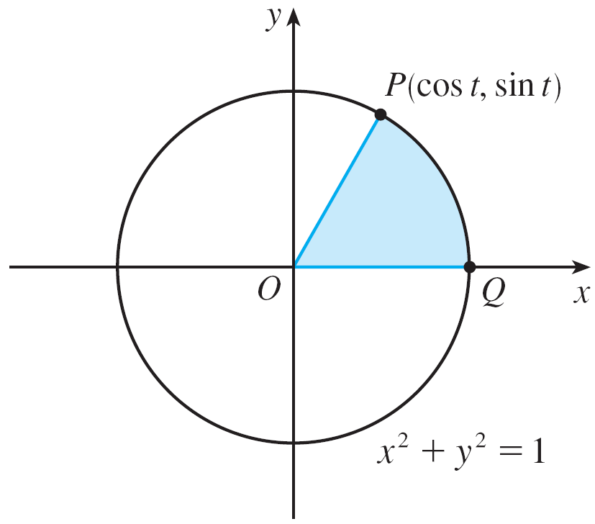
Hyperbolic Functions
The identity proved in Example 1(a) gives a clue to the reason for the name ‘hyperbolic’ functions, as follows:
If t is any real number, the point P(cos t, sin t) lies on the unit circle x² + y² = 1 because cos²t + sin²t = 1.
In fact, t can be interpreted as the radian measure of POQ in Figure 6.
Figure 6

Slide 14
Hyperbolic Functions
For this reason the trigonometric functions are sometimes called circular functions.
Likewise, if t is any real number, then the point P(cosh t, sinh t) lies on the right branch of the hyperbola x² – y² = 1 because cosh² t – sinh² t = 1 and cosh t ≥ 1.
This time, t does not represent the measure of an angle.

Slide 15
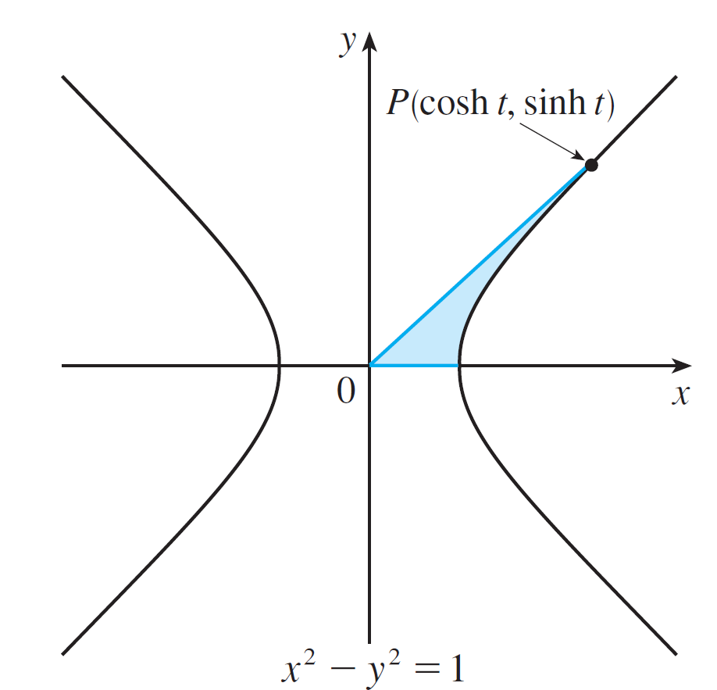
Hyperbolic Functions
However, it turns out that t represents twice the area of the shaded hyperbolic sector in Figure 7, just as in the trigonometric case t represents twice the area of the shaded circular sector in Figure 6.
Figure 6
Figure 7

Slide 16

Hyperbolic Functions
The derivatives of the hyperbolic functions are easily computed. For example,

Slide 17
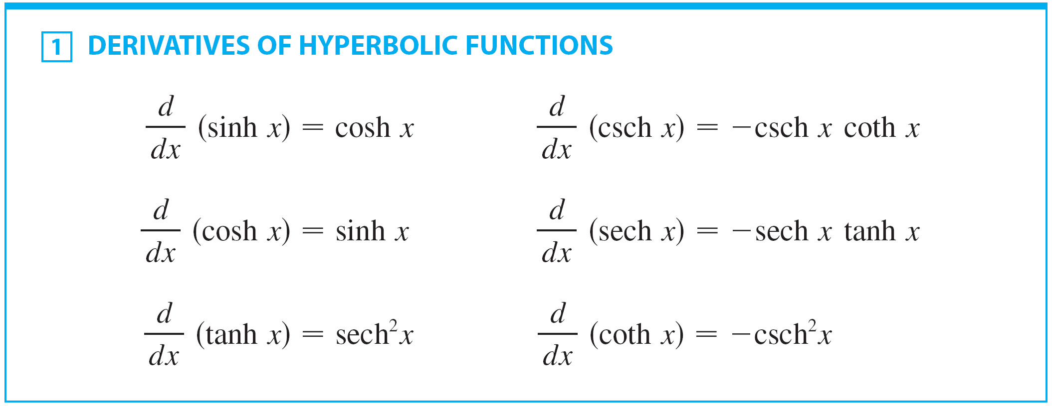
Hyperbolic Functions
We list the differentiation formulas for the hyperbolic functions as Table 1. Note the analogy with the differentiation formulas for trigonometric functions, but beware that the signs are different in some cases.

Slide 18


Example 2
Any of these differentiation rules can be combined with the Chain Rule.
For instance,

Slide 19
Inverse Hyperbolic Functions

Slide 20
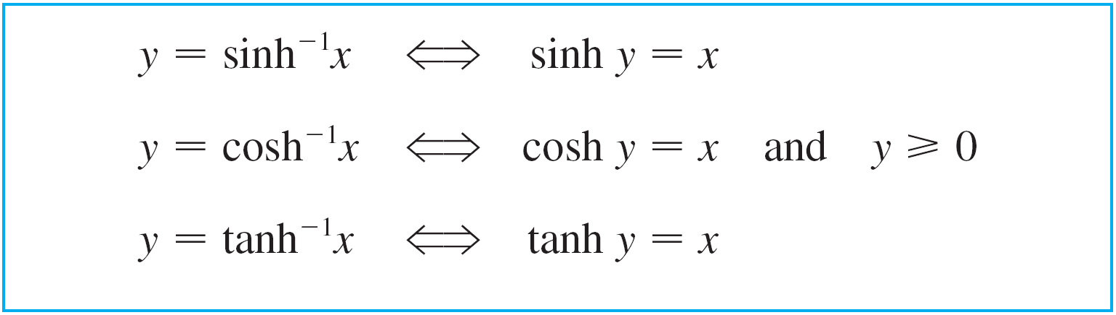

Inverse Hyperbolic Functions
We know that the sinh and tanh are one-to-one functions and so they have inverse functions denoted by sinh^{–1} and tanh^{–1}.
We also know that cosh is not one-to-one, but when restricted to the domain [0, ) it becomes one-to-one.
The inverse hyperbolic cosine function is defined as the inverse of this restricted function.

Slide 21
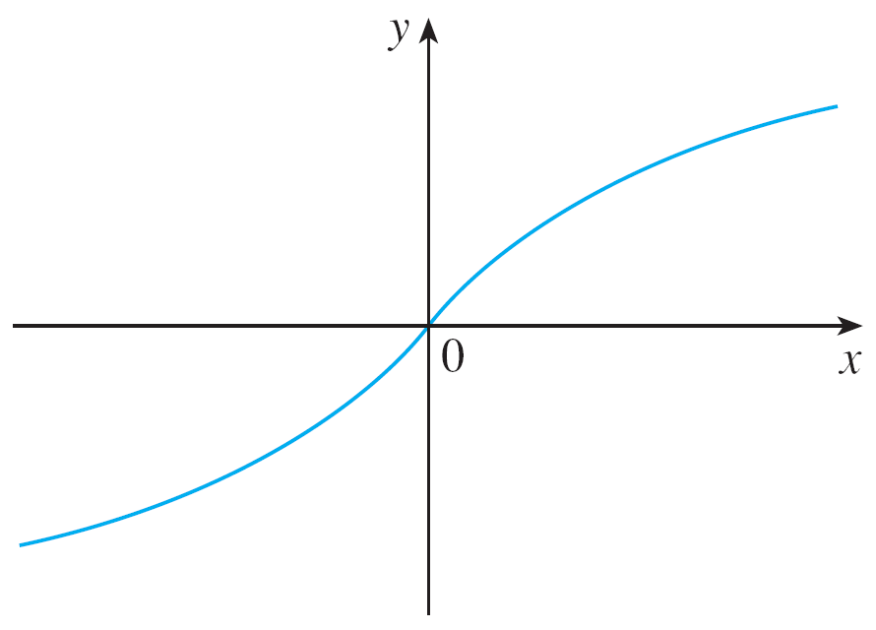
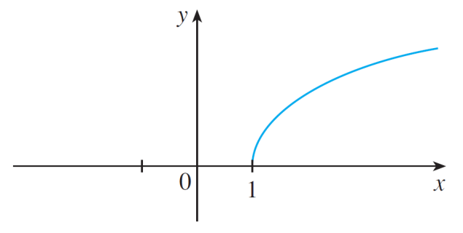
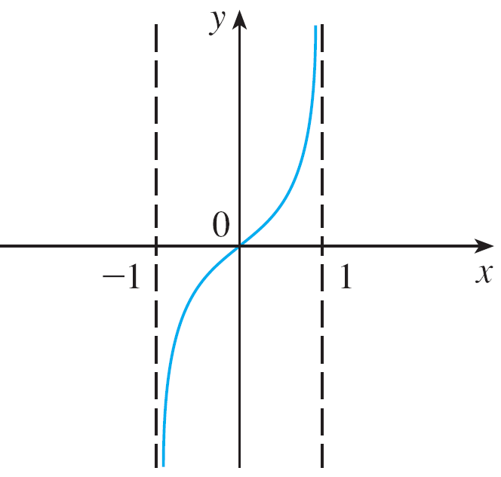




Inverse Hyperbolic Functions
We can sketch the graphs of sinh^{–1}, cosh^{–1}, and tanh^{–1} in Figures 8, 9, and 10.
Figure 8
Figure 9
Figure 10

Slide 22

Inverse Hyperbolic Functions
Since the hyperbolic functions are defined in terms of exponential functions, the inverse hyperbolic functions can be expressed in terms of logarithms. In particular, we have:

Slide 23

Example 3
Show that

Slide 24
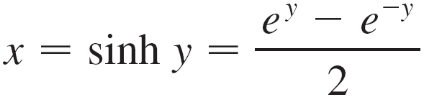


Example 3 – Solution
SOLUTION:
Let y = sinh^{–1}x.
Then
so
or, multiplying by e^{y},

Slide 25

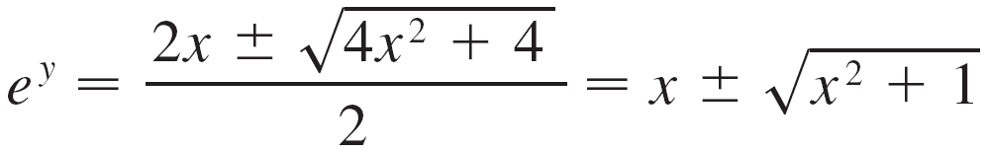



Example 3 – Solution
cont’d
This is really a quadratic equation in e^{y}:
Solving by the quadratic formula, we get
Note that , but
(because ).

Slide 26


Example 3 – Solution
cont’d
Thus the minus sign is inadmissible and we have
Therefore

Slide 27
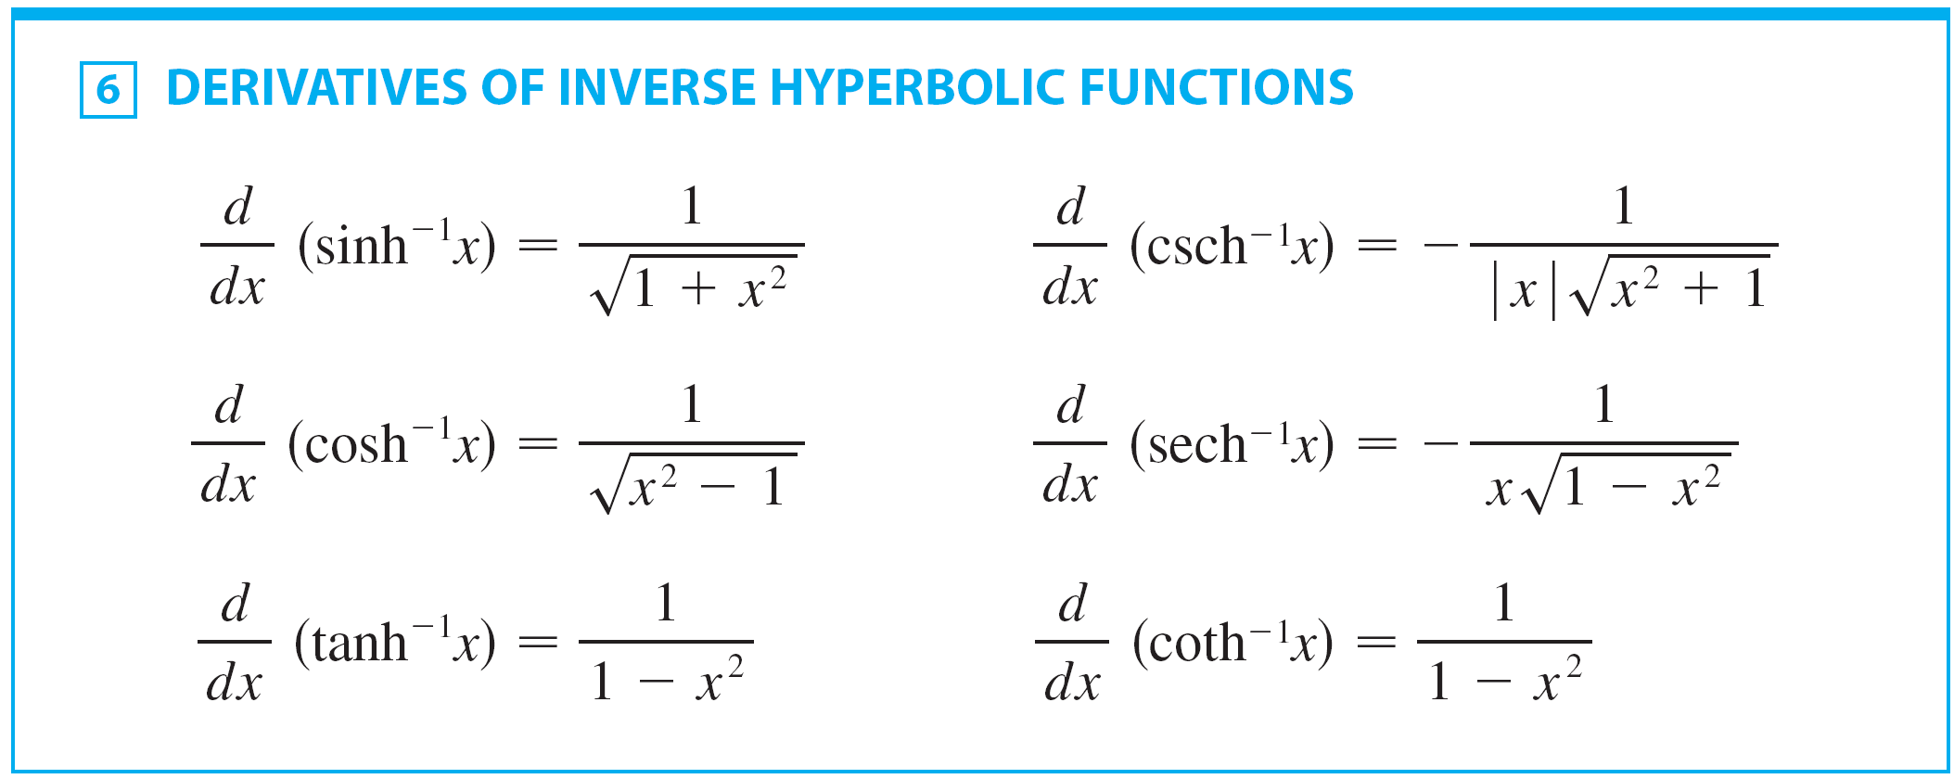
Inverse Hyperbolic Functions

Slide 28
Note
The formulas for the derivatives of tanh⁻¹x and coth⁻¹x appear to be identical.
However, the domains of these functions have no numbers in common:
tanh^{–1}x is defined for | x | < 1.
coth^{–1}x is defined for | x | >1.

Slide 29
DERIVATIVES
The inverse hyperbolic functions are all differentiable because the hyperbolic functions are differentiable.
The formulas in Table 6 can be proved either by the method for inverse functions or by differentiating Formulas 3, 4, and 5.

Slide 30
Example 4
Prove that .
SOLUTION
Let y = sinh^{–1} x. Then, sinh y = x.
If we differentiate this equation implicitly with respect to x, we get:
As cosh² y – sin² y = 1 and cosh y ≥ 0, we have:
So,

Slide 31
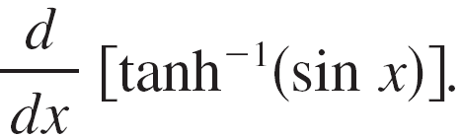
Example 5
Find

Slide 32
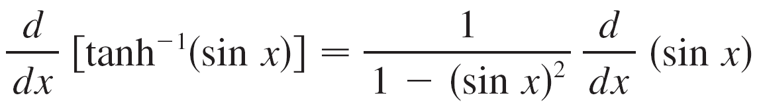
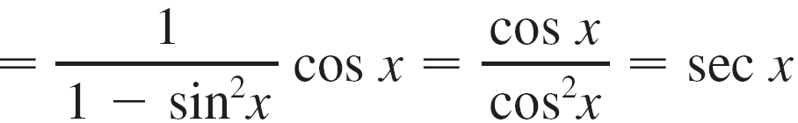
Example 5
SOLUTION:
Using Table 6 and the Chain Rule, we have

